Slide 2

Implementation of open science for P&N sources
Objectives
Participate in the construction of the EOSC
Make scientific data from Europe’s P&N sources FAIR
Facilitate the adoption of open data policies, standard metadata and data stewardship across Europé
Provide innovative data services to the users
Increase the impact of RIs by ensuring data can be used beyond the initial scope.
Promote the adoption of FAIR data principles, data stewardship and the EOSC in the community
Notes:
Objectives
* Participate in the construction of the EOSC by linking with the e-infrastructures and other ESFRI clusters.
* Make scientific data produced at Europe’s major Photon and Neutron sources fully compatible with the FAIR principles.
* Generalise the adoption of open data policies, standard metadata and data stewardship from 15 photon and neutron RIs and physics institutes across Europe
* Provide innovative data services to the users of these facilities locally and the scientific community at large via the European Open Science Cloud (EOSC).
* Increase the impact of RIs by ensuring data from user experiments can be used beyond the initial scope.
* Share the outcomes with the national RIs who are observers in the proposal and the community at large to promote the adoption of FAIR data principles, data stewardship and the EOSC.

Slide 3


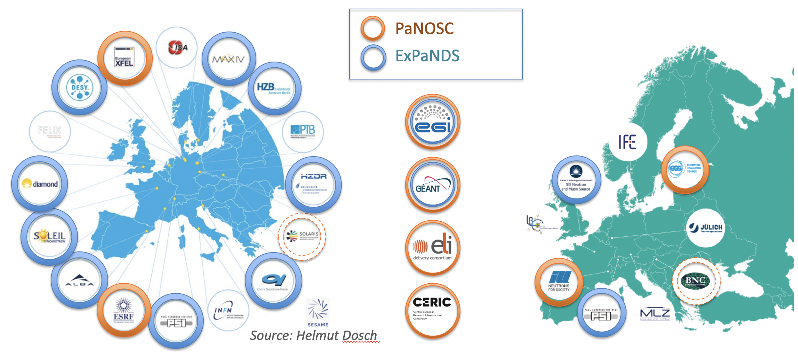
Partners in PaNOSC & ExPaNDS

Slide 4
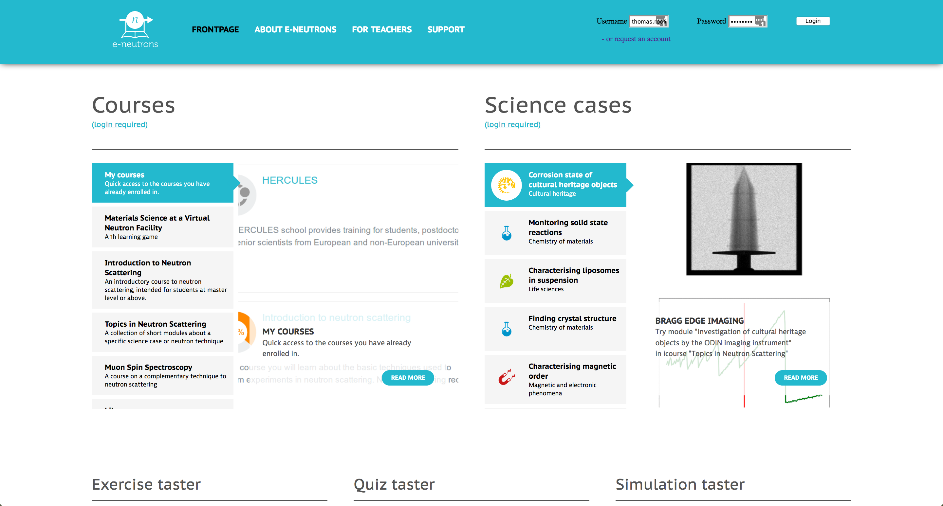


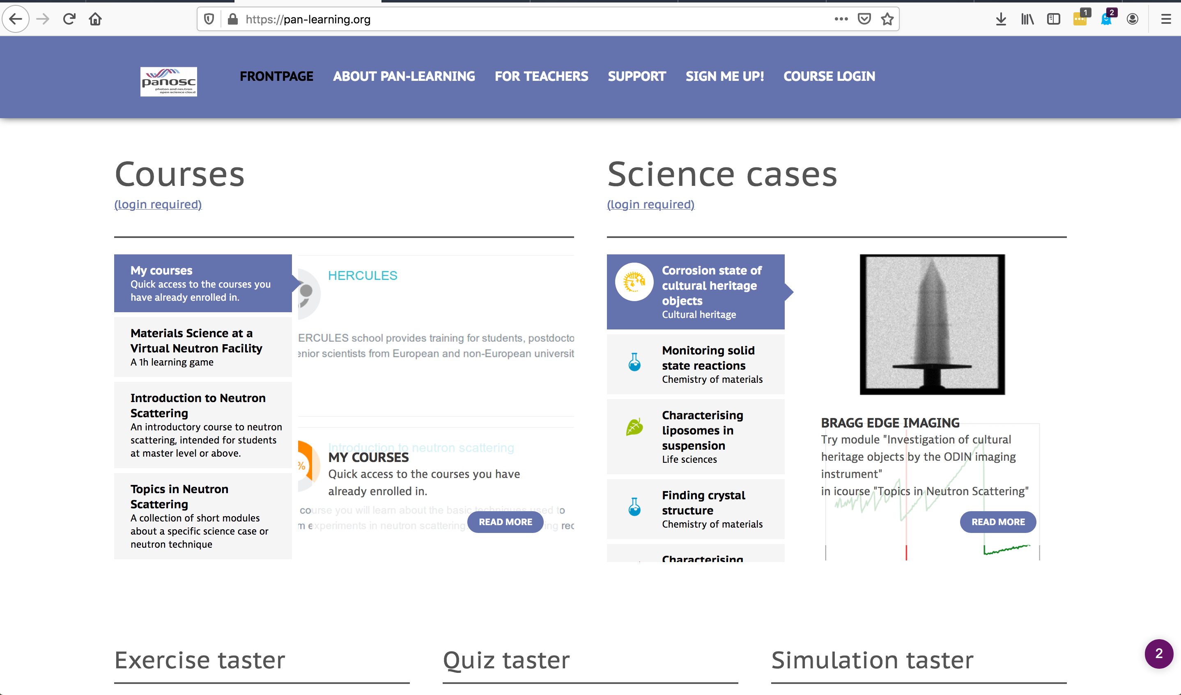

Common services developed in ExPaNDS & PaNOSC
https://e-neutrons.org
Some common services should be jointly operated and will need joint support beyond the life time of ExPaNDS & PaNOSC.
Common services:
Authentification and Authorization infrastructure (AAI): Common user authentification for all PaNOSC services
Training portal incl. e-learning platform
Common portal to open data
PaN Software catalogue
https://pan-learning.org

Slide 5
LENS – LEAPS collaboration / Joint IT WG
Examples of P&N collaborations
Potential objectives for LENS-LEAPS
PaNOSC | Photon and Neutron Open Science Cloud. EU project for ESFRIs
ExPaNDS | EOSC Photon and Neutron Data Service. EU project for national facilities
NeXus | data format for neutron, x-ray, and muon science
canSAS | collective action for nomadic small angle scatterers
ORSO | Open Reflectivity Standards Organisation
SasView | Small angle scattering analysis software
BornAgain | GISAS analysis software
Positioning of community in EOSC
Ensure continuous maintenance of cross-facility services developed in ExPaNDS & PaNOSC:
AAI infrastructure
Training portal
Software catalogue
Common portal to open data
Support for open data and adopting common data policy, e.g. by creating a PaN data committee
Support for interoperability, e.g. through NeXus
Reaching out to other relevant Horizon Europe Partnerships such as “AI, Data, and Robotics”
Joint efforts for attracting EU funding

Slide 6

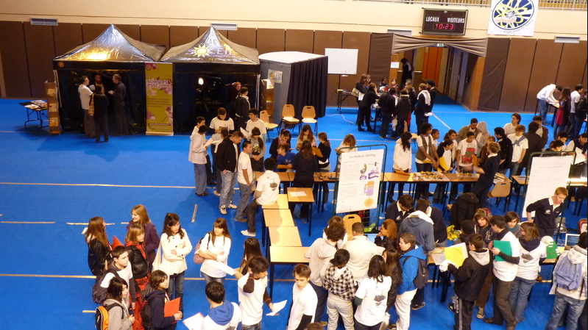

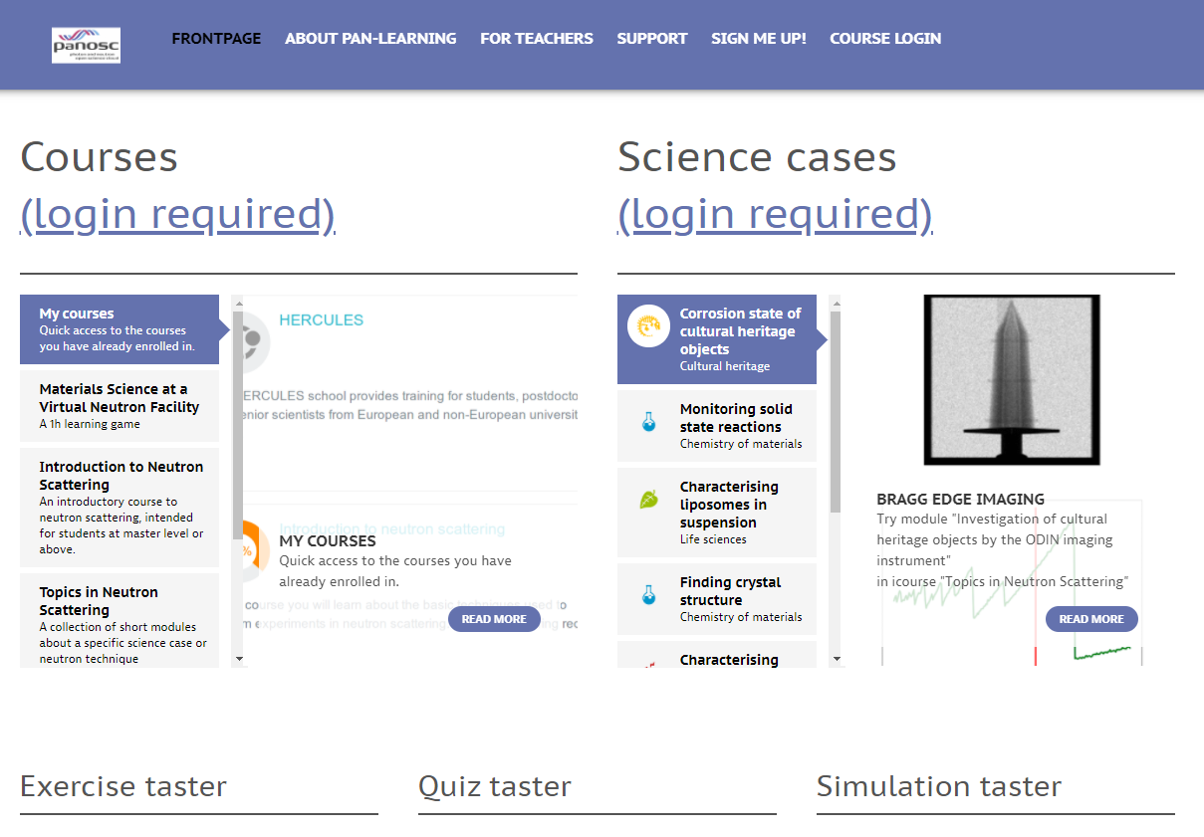
PaN training portal
Ambition
Training events
Catalogue of training events of interest for the PaN community (Online and f2f events)
Workshops, MOOCs, summer schools, users’ meetings …
Training material
Catalogue of training materials of interest for the PaN community
External links to content provider’s website or repositories as Github, GitLab, Zenodo, Open Aire, etc
E-learning platform
Tool available to create and store training material
Moodle with Jupyter integration
Simulation tools
MediaWiki

Slide 7
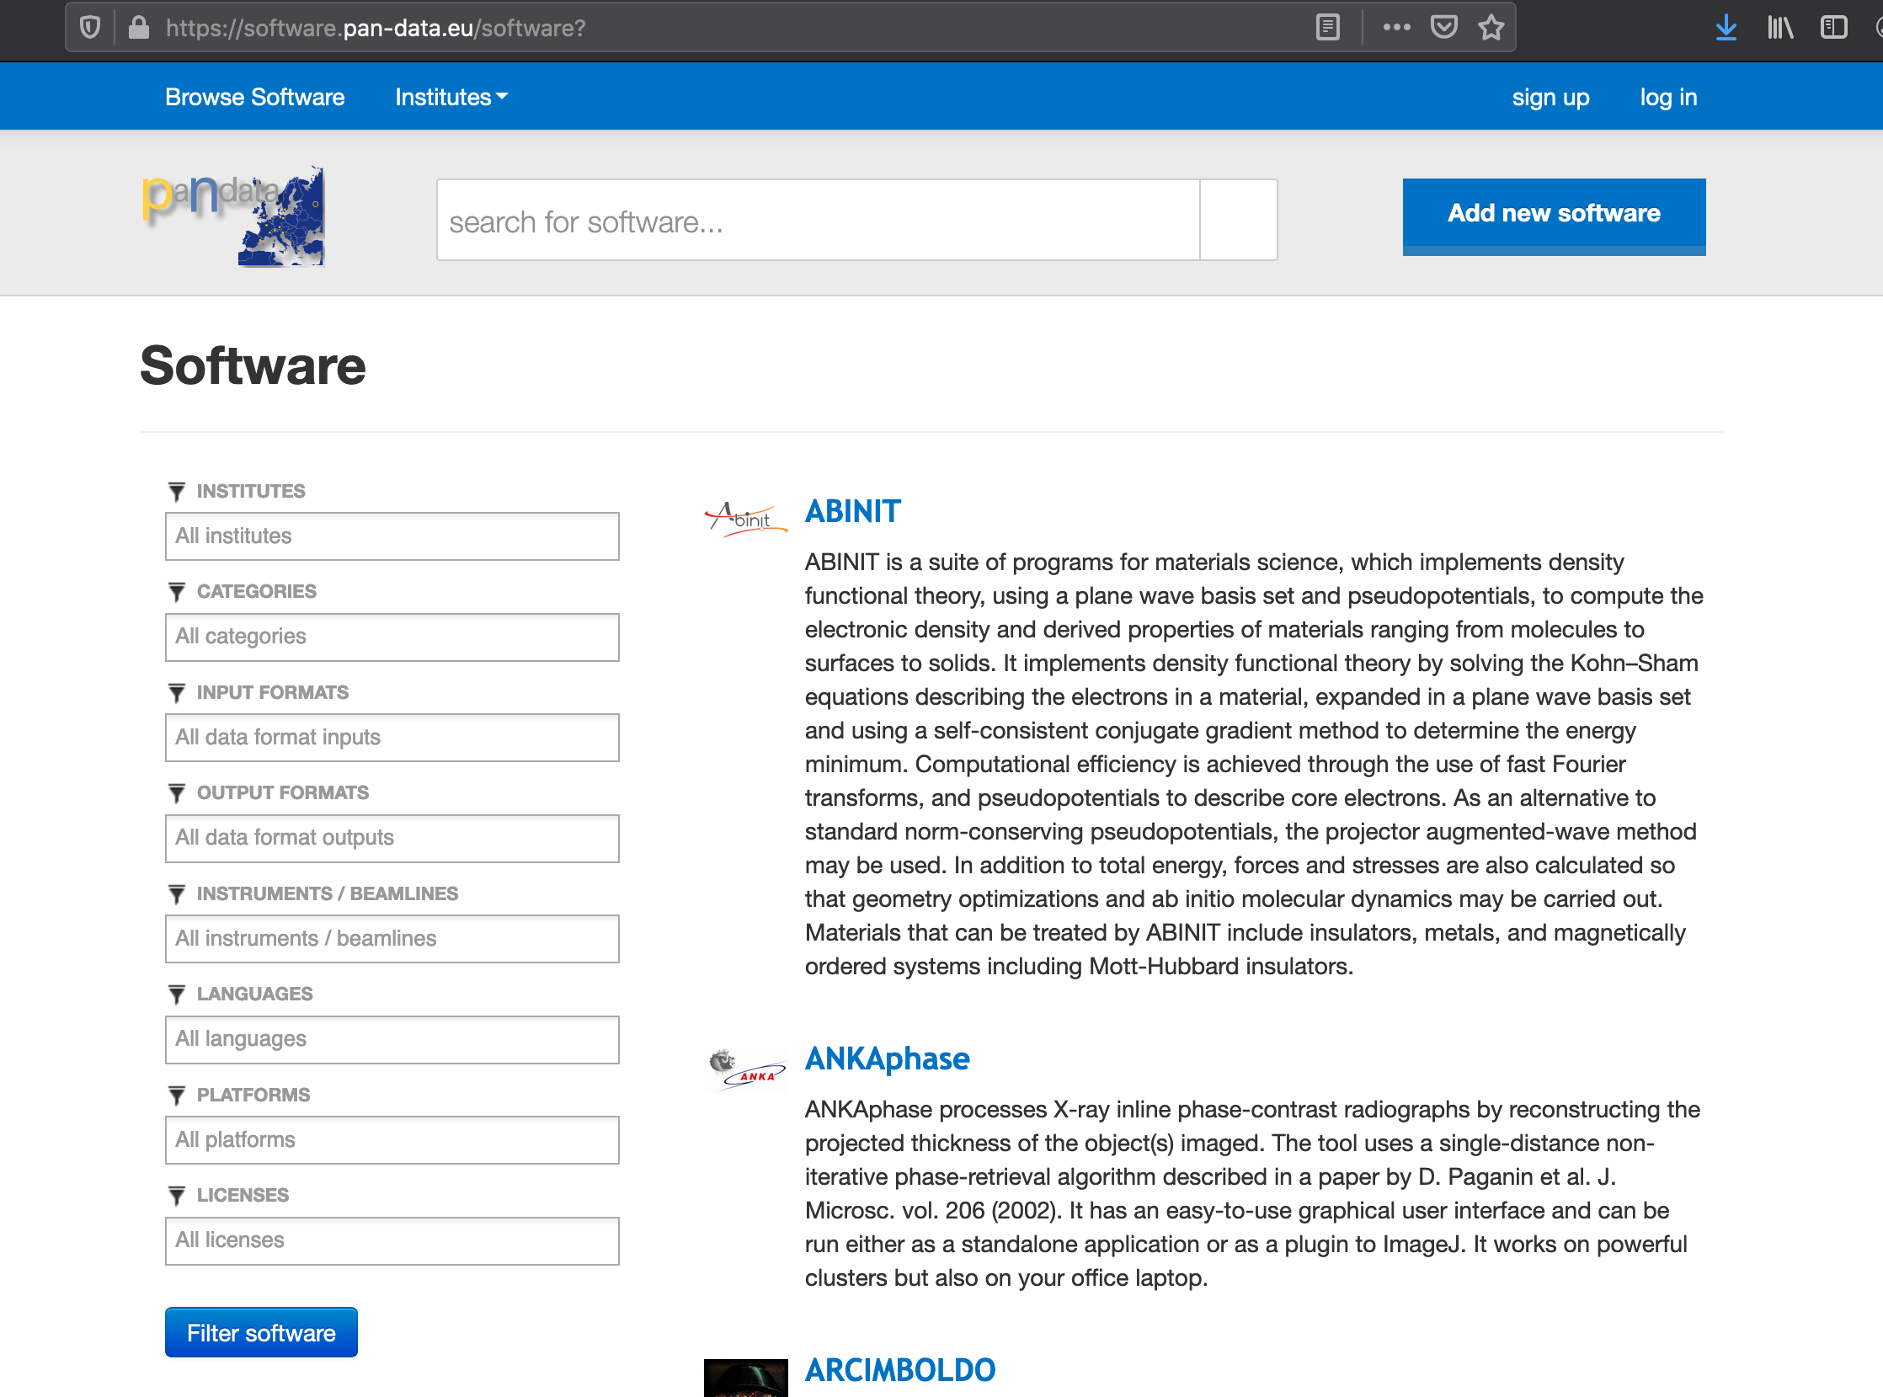
PaN software catalogue

